Slide 1
String Processing
Lê Sỹ Vinh
Computational Science and Engineering
Email: vinhls@vnu.edu.vn

Slide 2
Outlines
String matching
Regular expression

Slide 3
String
String is an array of characters.
For example: S = “Matching is a string algorithms”
Substring is a continuous part of a string
Example: s = “a string” is a substring of S.
A prefix string is a substring of S that includes the first character of S.
Example: S = “Algorithm”
Prefix of S: A, Al, Alg,....Algorithm
A suffix string is substring of S that includes the last character of S.
Example: S = “Algorithm”
Suffix of S: m, hm, thm, ithm...Algorithm

Slide 4
String matching problem
Problem: Given a short string (pattern) P and a long string S (text), determine whether if the pattern P appears in the text S.
Example:
S = “Hello to string algorithms”
P = “algorithm”

Slide 5
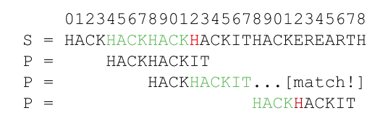
Naïve string matching
Moving from the begin to the end of the text S, for each position determine if the pattern P appears at the position.

Slide 6
Naïve string matching
Algorithm Naïve (P, S):
Let m be the length of S
Let n be the length P
For x from 0 to m – n do
if P = S[x…(x + n – 1)]:
return “P in S”
return “P not in S”
Complexity: O(mn)

Slide 7
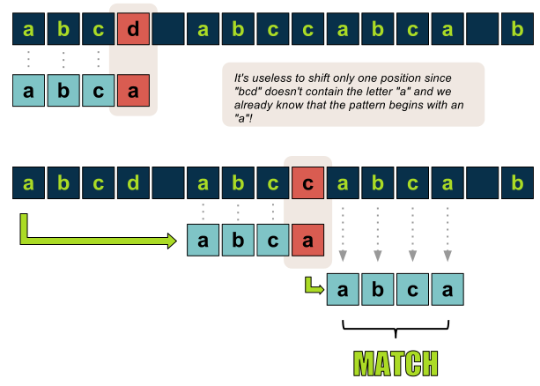
Knuth Morris Pratt Algorithm
Idea: Whenever a mismatch occurs, we shift the pattern as far as possible to avoid redundant comparisons
Complexity: O(m+n)

Slide 8
Exercises on string
Given a string, write an algorithm to determine all duplicate words in the string.
Given a string, write an algorithm to check if it contains only digits

Slide 9
Regular expression
Problem: How to find patterns such as email addresses, URLs in a string or
text?
A regular expression (regex) defines a pattern of characters with conditions:
Examples:
“regular expression” matches exactly the text “regular expression”
“oo+h!” matches “ooh!”, “oooh!’, “ooooh!”, etc.
“colo?r” matches color or colour
“beg.n” matches begin, began, begun, etc.
The search pattern can be anything from a simple character, a fixed string or a complex expression containing special characters.
The pattern defined by the regex may match one or several times or not at all for a given string.

Slide 10
Common matching symbols
Regular expression | Description | Example
. | Matches any characters | /beg.n/ => “begin”, “began”, “begun”
^regex | Find the regex that must match at the beginning of the string | /^sit/ => “site”, “sitcom” but not “visit”, “deposit”
regex$ | Find the regex that must match at the end of the string | /ext$/ => “next”, “context” but not “extra”, “extent”
[abc] | Match either a or b or c | /[fg]un/ => “fun”, “gun”
[^abc] | Match any character except a, b, c | /[^fg]un/ => “run”, “sun”
[1-9] | Match any digit from 1 to 9 | /any[1-9]/ => any1, any2

Slide 11
Meta characters
Regular expression | Description | Example
\d | Any digit, short for [0-9] | /\d\d/ => “01”, “02” … “99”
\D | A non-digit, short for [^0-9] | /c\Dt/ => “cat”, “cut” but not “c4t”
\s | A white space character | /get\sup/ => “get up”
\w | A word character, short for [a-z,A-Z0-9_] | /h\wt/ => “hAt”, “hot”, “h0t”, “h1t”

Slide 12
Quantifier
Regular expression | Description | Example
regex* | Regex occurs zero or more times | /buz*/ => “bu”, “buz”, “buzz”, “buzzzzzz”
regex+ | Regex occurs one or more times | /lo+ng/ => “long”, “loooooong” but not “lng”
regex? | Regex occurs zero or one time | /colou?r/ => “color”, “colour”
regex{X} | regex occurs X times | /\d{3}/ => “016”, “752”
regex{X,Y} | Regex occurs between X and Y times | /\w{3,4}/ => “int”, “long” but not “double”

Slide 13
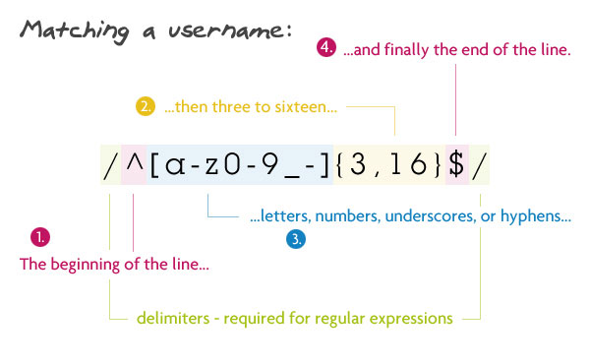
Examples

Slide 14
Regular expression for a password

Slide 15
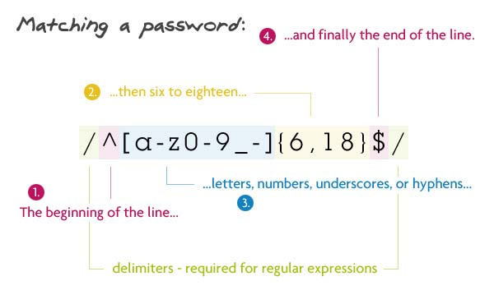
Regular expression for a password

Slide 16
Regular expression for an email

Slide 17
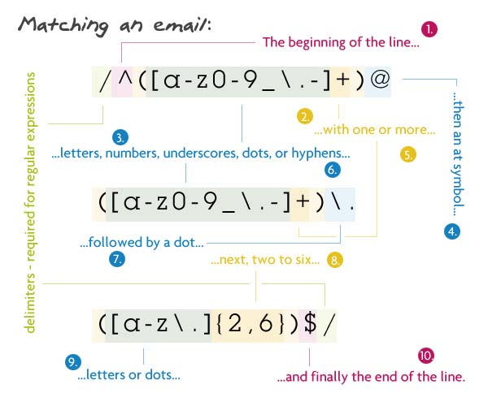
Regular expression for an email

Slide 18
Regular expression a URL

Slide 19
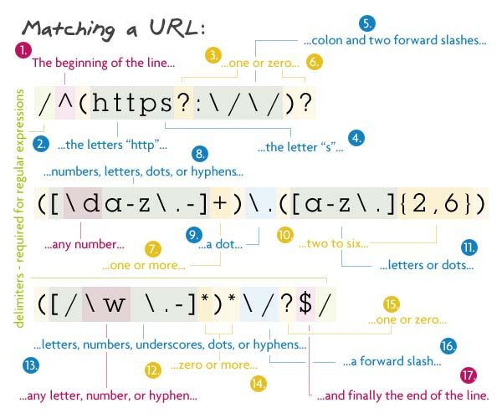
Regular expression a URL

Slide 20
Regular expression for an IP address

Slide 21
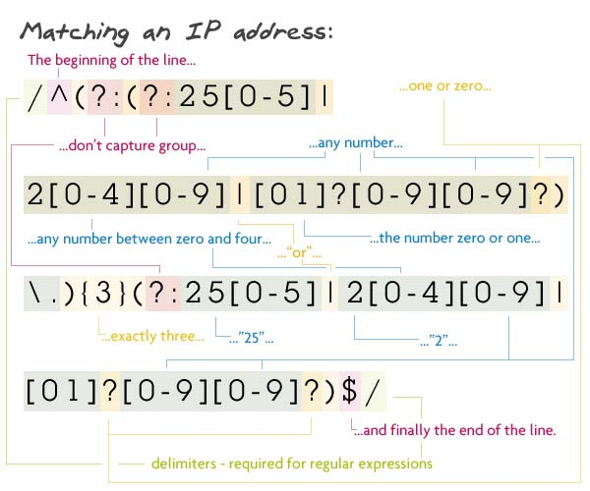
Regular expression for an IP address

Slide 22
Regular expression for a variable

